Slide 1

Group G: Secure File Transfer System using ASCON (updated)
Group G: Hyung Jin Kim, Nourine Mahmoud, Hogan Leu, Ignacio Velasco, Sophia Yu

Slide 2

Secure File Transfer System using Lightweight Encryption
Will be made with one Raspberry pi 5 and two laptops.
Can transfer either text or images (potentially video)
The Raspberry pi will take video in and encrypt it using ASCON to send to one Laptop
The 1st laptop will then decrypt it using ASCON and display the decrypted video while also sending an encrypted video to the 2nd laptop which will do the same as the 1st laptop without sending it.
Use Paramiko for secure communication
Since it is generally better because it provides robust, built-in security features
simplifies the process of setting up secure connections
Wi-Fi Script to enable pi to connect to Wifi to transfer files over local network
Use Diffie-Hellman Key Exchange with RSA-2048.

Slide 3
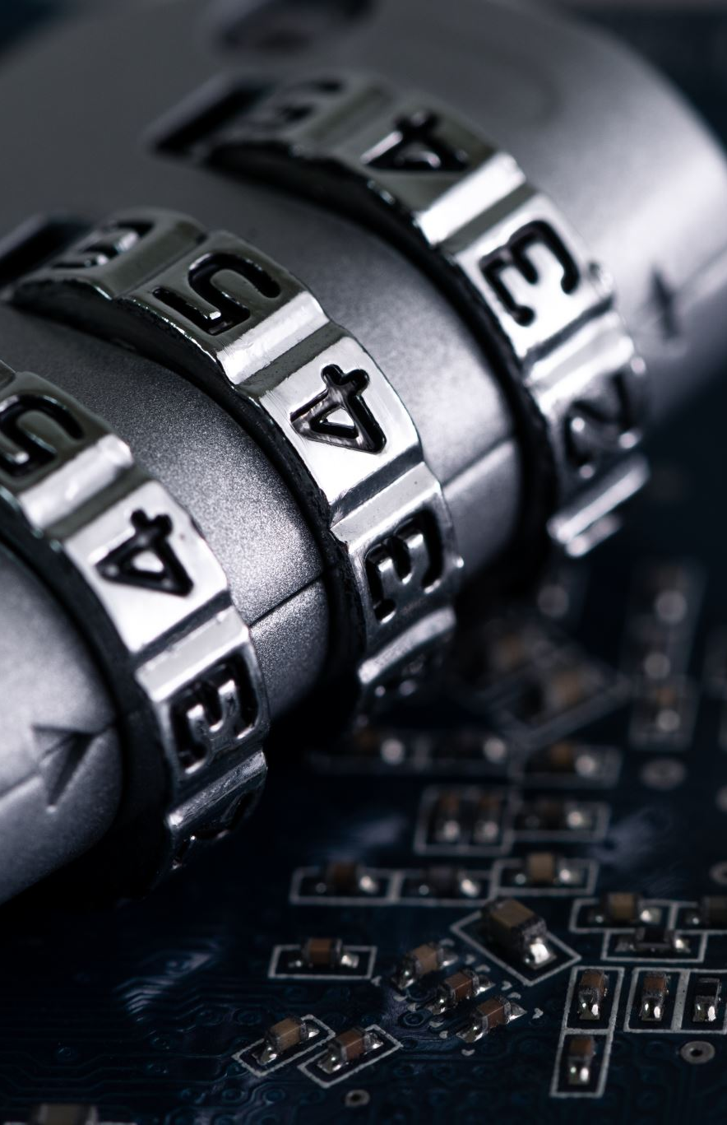
Real World Applications
Can be used to Encrypt IoT devices where there are limited resources.
Real world application
The Artemis Project

Slide 4

Risk Analysis
This project can be completed with about two weeks of work (potentially less due to group size)
There is an 89.5 % chance of successfully completing this project on time.
In the 10.5% chance it doesn’t seem like the project will be completed the following will be changed to ensure there is a deliverable on the due date.
Instead of ASCON use a different method of encryption such as RSA or AES
Only focus on sending still images
Instead of the 1st laptop decrypting video frame it will decrypt a still image and display it while sending a still frame to the 2nd laptop (this will also be encrypted)

Slide 5

Deliverables
Performance Metrics
Time it takes to encrypt
Frames Per Second
Temperature of the Pi5
Time it takes to decrypt
Time it takes to exchange keys
Time it takes to send from one location to the next
RP5 → Laptop 1 → Laptop 2

Slide 6

The End

